Slide 1

看門狗
WatchDog
►

Slide 2

WatchDog
►
大多數開發人員都習慣使用看門狗程式來保護嵌入式應
用系統。
► 不幸的是，簡單的設計概念可能造成複雜的設計錯誤。
► 設計一個完美的硬體和軟體系統是很困難的，使用錯誤
檢測和回復的設計是必要的，一個常用的技巧就是看門
狗。
► 看門狗計時器是一個硬體電路，會一直計數到設定值，
然後產生一個信號，通常連接到reset，使系統重新開機。
► 一個正常的系統，在看門狗計數到達設定值之前，必須
重新設定計數器，以避免重新開機。
► 看門狗是作為最後的故障安全機制，用來處理不可恢復
的錯誤。

Slide 3
WatchDog
►
開機後，看門狗必須盡快啟用，否則軟體出現錯誤，看
門狗將無法啟動。
► 看門狗的時脈如果是來自外部，必須注意硬體故障，使
其無法工作。
► 為了避免系統在不正常運作下，錯誤的軟體還是可以觸
發看門狗，通常觸發看門狗都有特殊的設計。
► 過於頻繁的觸發看門狗並不會造成問題。
► 除錯時，在debugger的中斷點，若看們狗的計時器還是繼
續，將會造成除錯的困擾，可以先關閉看門狗。
► 看門狗的設定時間不宜太長，必須避免當掉後到重新開
機之間可能造成的損害。

Slide 4
課程大綱 (Lesson Outline)
►
Cortex-M0 MCU 看門狗計數設計原理
– 看門狗(WatchDog)
► 實習範例 : Test_WDT_7seg
►
範例練習: WDT看門狗計數器
– 利用範例修改出使用WDT 看門狗之程式

Slide 5
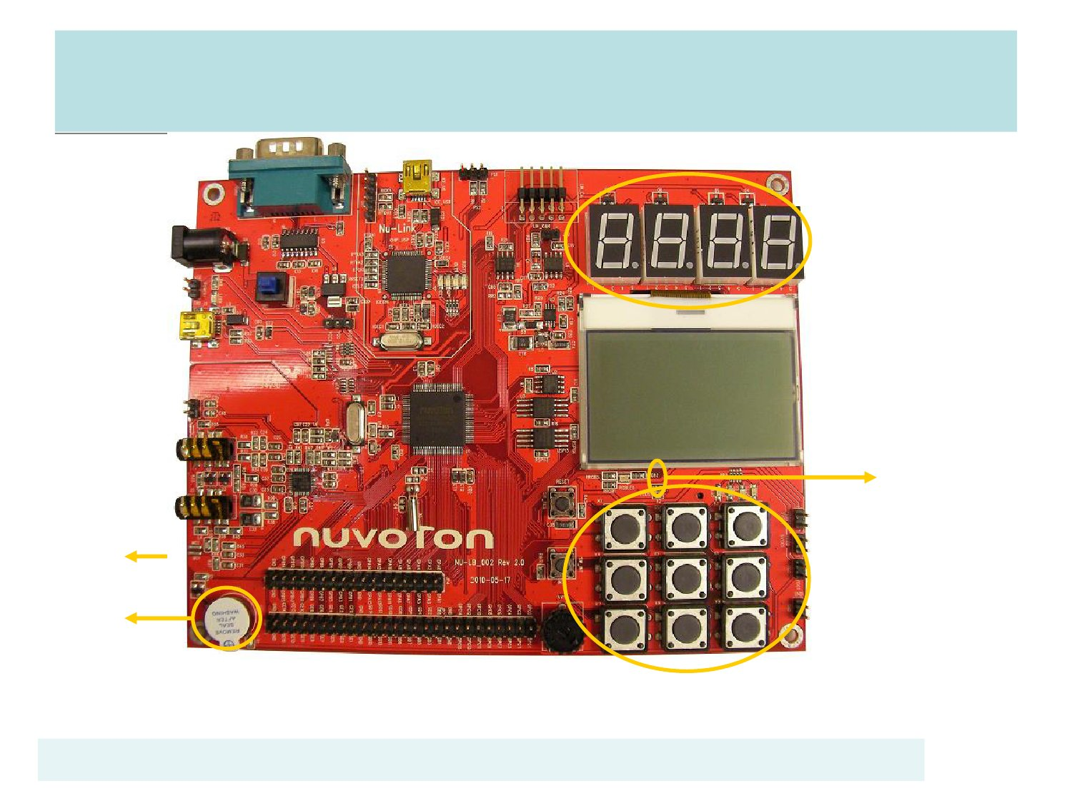
NU-LB-NUC140 開發板
7 segment LEDs
RGB LED
GPA12,13,14
SW Int
GPB15
Buzzer
GPB11
Keypad

Slide 6
WatchDog Features
► 18-bit
up counter
► 8 selections of time out period
► Support function:
– WDT interrupt
– WDT reset
– WDT wakeup

Slide 7
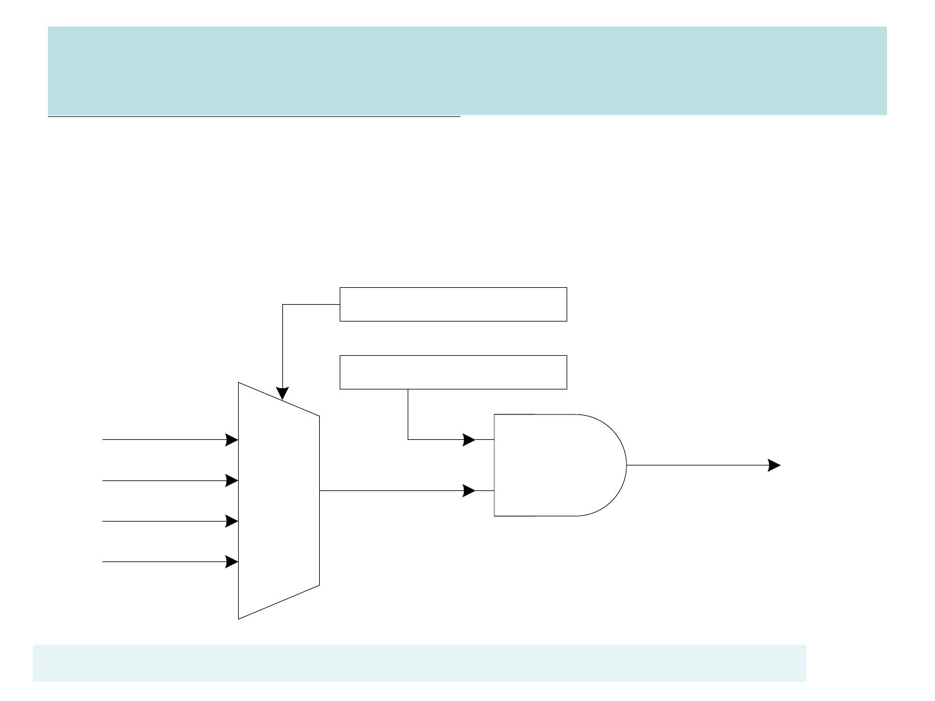
WDT Clock Source
//: 11 = Clock source from internal 10 kHz
SYSCLK->CLKSEL1.WDT_S =3;
//: 1 = Enable Watchdog Timer Clock
看門狗使用10KHz作為時脈
1.內建的clock，不須外加
2.週期為0.1ms，計算容易
SYSCLK->APBCLK.WDT_EN =1;
WDG_S (CLKSEL1[1:0])
WD_CLK_EN(APBCLK[0]
10KHz
HCLK/2048
32K
12M
11
10
01
00
WDT_CLK

Slide 8
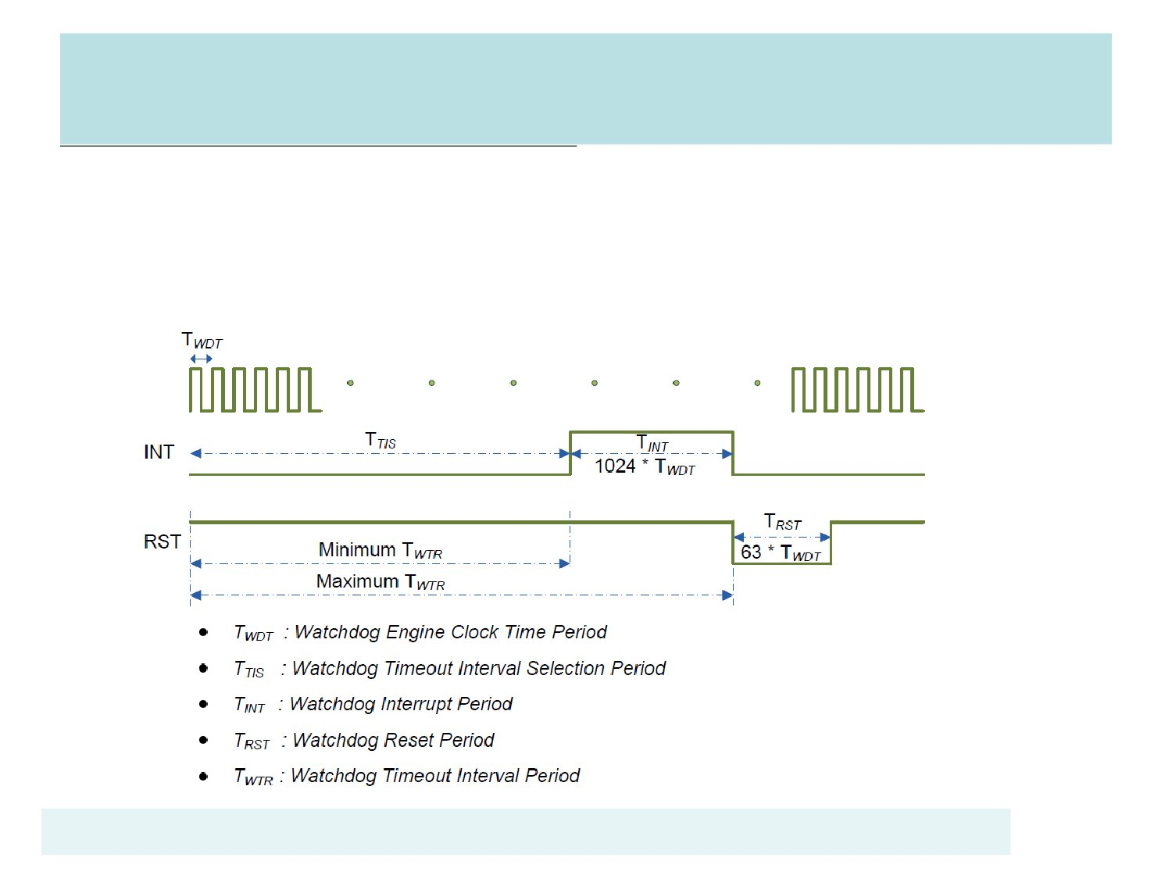
WatchDog Timer
►
WatchDog從0計數到TTIS=2n*TWDT，然後產生中斷
► 在T INT=1024*TWDT結束前，必須reset WDT timer
► 否則產生RESET信號
T WDT一般用10K作為時序，每一周期0.1ms
102.4ms
6.3ms

Slide 9
WatchDog
►
在WatchDog到達設定時間之前，必須reset WatchDog
的計時器，否則進入中斷。
►
在中斷時間有1024TWDT，如果能修正錯誤，則reset
WatchDog的計時器，返回程式。否則紀錄錯誤訊息，
在1024TWDT之後，送出reset信號，重新開機。
►
WatchDog也可用來將CPU從power down 模式喚醒。

Slide 10
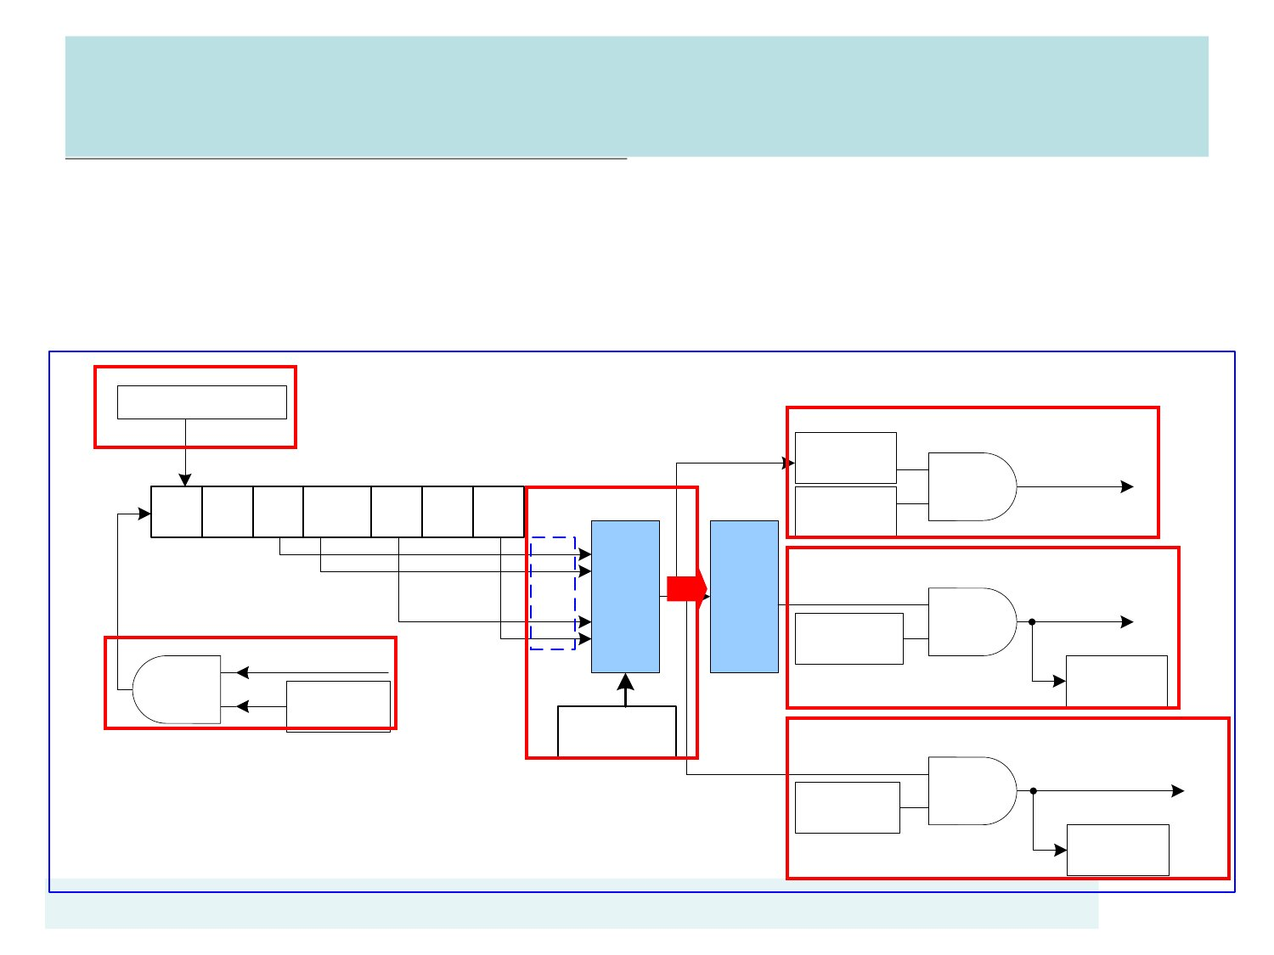
Watch mode Block Diagram
WDT: cause a WDT Interrupt after time out.
► WDT: Reset CPU after (time out + 1024WDT clocks).
► WDT: wakeup CPU form Power-down mode after time out .
WTR(WDTCR[0])
►
Reset WDT
Counter
WTIF
(WTCR[3])
Watchdog
Interrupt
18-bit WDT Counter
0
..
4
…...
WDT_CLK
WTE
(WTCR[7])
15
16
17
WTIE
(WTCR[6])
WTRE
(WTCR[1])
WTWKE
(WTCR[4])
000
001
:
:
110
111
Delay
1024
WDT
clocks
Watchdog
Reset
WTRF
(WTCR[2])
Wakeup CPU from
Power-down mode
WTWKF
(WTCR[5])
Time-
out
select
WDTCR.
WTIS[10:8]

Slide 11
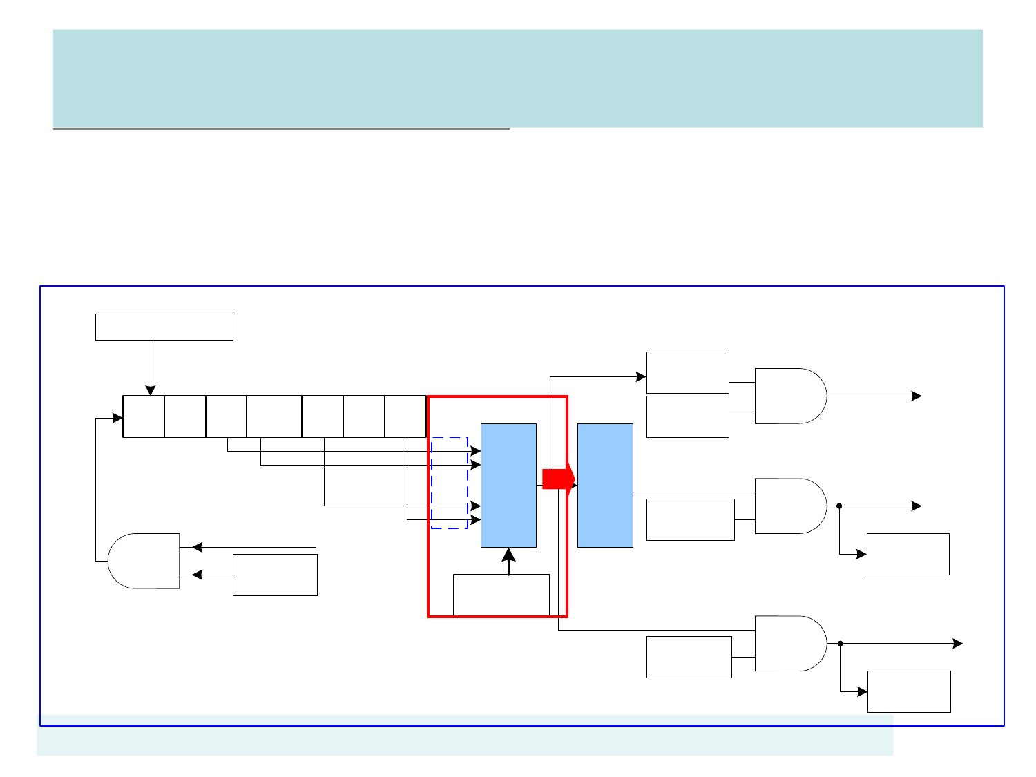
Watch mode Block Diagram
WTCR.WTIS=000(24), 001(26), 010(28), 011(210), 100(212), 101(214),
110(216), 111(218)週期
WDT->WTCR.WTIS=5; //214週期
WTR(WDTCR[0])
►
►
Reset WDT
Counter
WTIF
(WTCR[3])
Watchdog
Interrupt
18-bit WDT Counter
0
..
4
…...
WDT_CLK
WTE
(WTCR[7])
15
16
17
WTIE
(WTCR[6])
WTRE
(WTCR[1])
WTWKE
(WTCR[4])
000
001
:
:
110
111
Delay
1024
WDT
clocks
Watchdog
Reset
WTRF
(WTCR[2])
Wakeup CPU from
Power-down mode
WTWKF
(WTCR[5])
Time-
out
select
WDTCR.
WTIS[10:8]

Slide 12
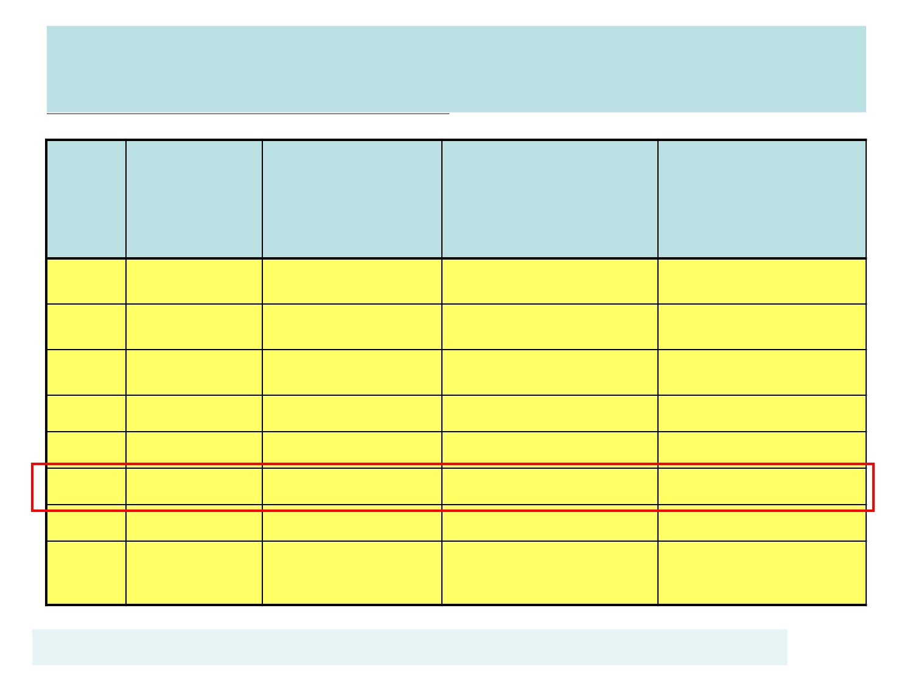
WDT Time out selection
Interrupt
Timeout
WDT_CLK
24(16)
26 (64)
28 (256)
210 (1024)
212 (4096)
214 (16384)
216 (65536)
218
(262144)
Watchdog
Reset Timeout
WDT_CLK
(24 + 1024)
(26 + 1024)
(28 + 1024)
(210 + 1024)
(212 + 1024)
(214 + 1024)
(216 + 1024)
(218 + 1024)
WTR Timeout
Interval for Reset
(WDT_CLK=12M
Hz)
86.67us
90.67 us
106.67 us
170.67 us
426.67 us
1.45 ms
5.55 ms
21.93 ms
WTR Timeout
Interval for Reset
(WDT_CLK=10K
Hz)
1.6+102.4ms
6.4+102.4 ms
25.6+102.4 ms
102.4+102.4 ms
409.6+102.4 ms
1638.4+102.4ms
6553.6+102.4ms
26214.4+102.4 ms
WTIS
000
001
010
011
100
101
110
111
`

Slide 13
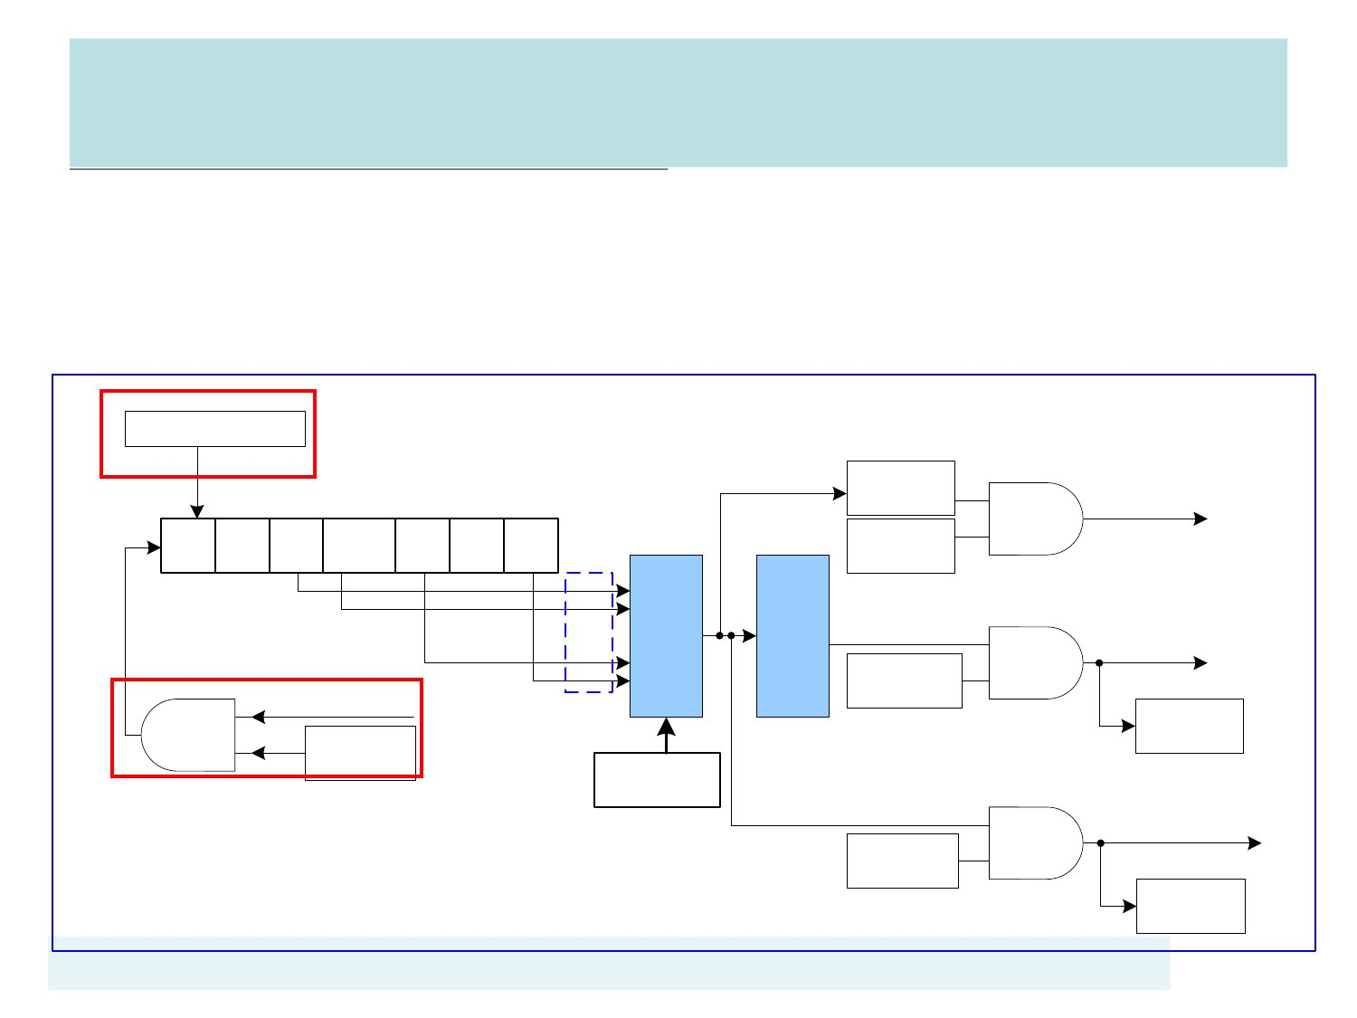
Watch mode Block Diagram
►
WDT->WTCR.WTE = 1;
► WDT->WTCR.WTR = 1;
WTR(WDTCR[0])
// Enable the WDT
// Reset Contents of the Watchdog timer
Reset WDT
Counter
WTIF
(WTCR[3])
Watchdog
Interrupt
18-bit WDT Counter
0
..
4
…...
WDT_CLK
WTE
(WTCR[7])
15
16
17
WTIE
(WTCR[6])
WTRE
(WTCR[1])
WTWKE
(WTCR[4])
000
001
:
:
110
111
Delay
1024
WDT
clocks
Watchdog
Reset
WTRF
(WTCR[2])
Wakeup CPU from
Power-down mode
WTWKF
(WTCR[5])
Time-
out
select
WDTCR.
WTIS[10:8]

Slide 14
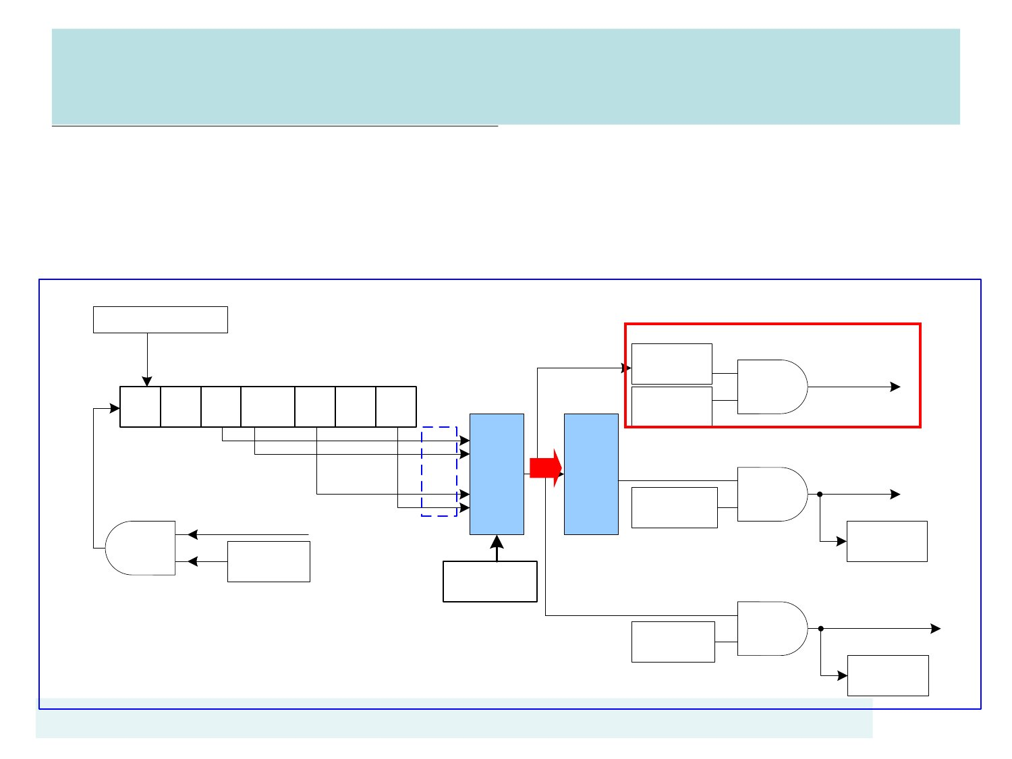
Watch mode Block Diagram
►
WDT->WTCR.WTIF =1;
WDT->WTCR.WTIE = 1;
//1=Write 1 to clear WDT Interrupt Flag
//1 = Enable the WDT interrupt
►
►
NVIC_EnableIRQ(WDT_IRQn); //(NUC1xx.h) WDT_IRQn=1
WTR(WDTCR[0])
Reset WDT
Counter
WTIF
(WTCR[3])
Watchdog
Interrupt
18-bit WDT Counter
0
..
4
…...
WDT_CLK
WTE
(WTCR[7])
15
16
17
WTIE
(WTCR[6])
WTRE
(WTCR[1])
WTWKE
(WTCR[4])
000
001
:
:
110
111
Delay
1024
WDT
clocks
Watchdog
Reset
WTRF
(WTCR[2])
Wakeup CPU from
Power-down mode
WTWKF
(WTCR[5])
Time-
out
select
WDTCR.
WTIS[10:8]

Slide 15
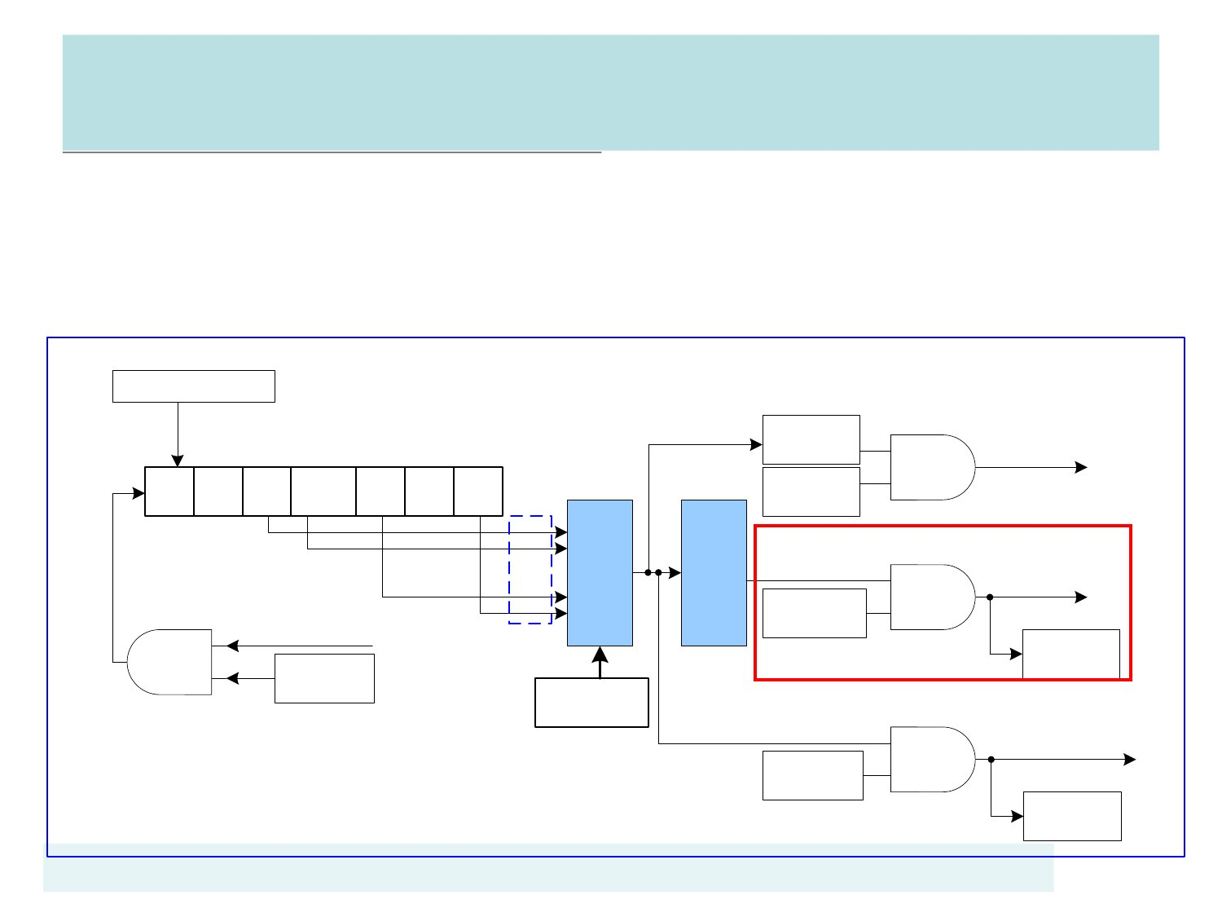
Watch mode Block Diagram
WDT->WTCR.WTRE = 1; //1 = Enable WDT reset function
WDT->WTCR.WTRF = 1; //1= clear Watchdog Timer Reset Flag
WTR(WDTCR[0])
►
►
Reset WDT
Counter
WTIF
(WTCR[3])
Watchdog
Interrupt
18-bit WDT Counter
0
..
4
…...
WDT_CLK
WTE
(WTCR[7])
15
16
17
WTIE
(WTCR[6])
WTRE
(WTCR[1])
WTWKE
(WTCR[4])
000
001
:
:
110
111
Delay
1024
WDT
clocks
Watchdog
Reset
WTRF
(WTCR[2])
Wakeup CPU from
Power-down mode
WTWKF
(WTCR[5])
Time-
out
select
WDTCR.
WTIS[10:8]

Slide 16
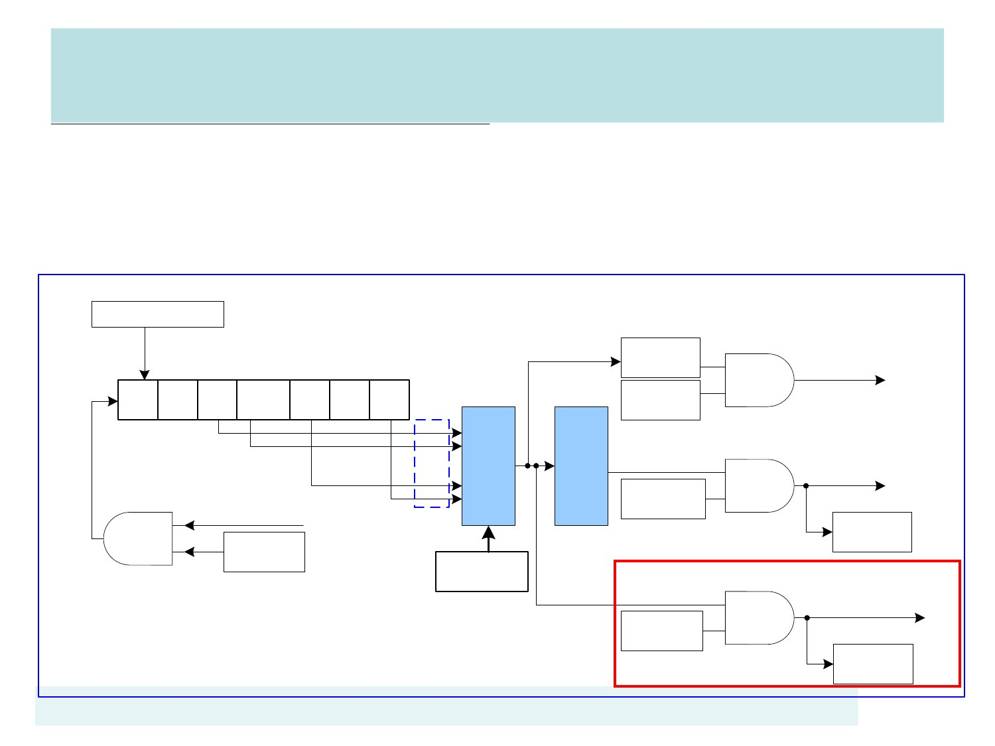
Watch mode Block Diagram
WDT->WTCR.WTWKE=1; // Enable the wake_up function
► WDT->WTCR.WTWKF=1; // clear Watchdog Timer Wake-up Flag
WTR(WDTCR[0])
►
Reset WDT
Counter
WTIF
(WTCR[3])
Watchdog
Interrupt
18-bit WDT Counter
0
..
4
…...
WDT_CLK
WTE
(WTCR[7])
15
16
17
WTIE
(WTCR[6])
WTRE
(WTCR[1])
WTWKE
(WTCR[4])
000
001
:
:
110
111
Delay
1024
WDT
clocks
Watchdog
Reset
WTRF
(WTCR[2])
Wakeup CPU from
Power-down mode
WTWKF
(WTCR[5])
Time-
out
select
WDTCR.
WTIS[10:8]

Slide 17
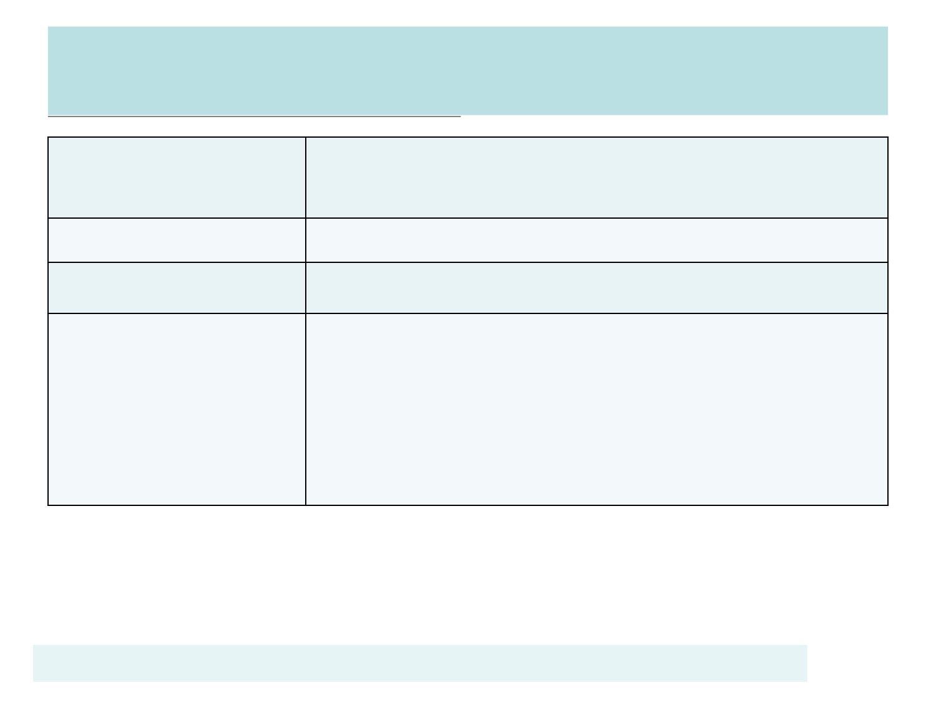
WatchDog Driver
DrvWDT_Open
DrvWDT_Close
enable WDT engine clock,
set WDT time-out interval.
stop/disable WDT relative functions.
DrvWDT_InstallISR install WDT interrupt service routine
DrvWDT_Ioctl
start/stop the WDT,
enable/disable WDT interrupt function,
enable/disable WDT time-out wake up function,
enable/disable system reset when WDT time-out,
set the WDT time-out interval.

Slide 18
DrvWDT_Open
►
Enable WDT engine clock and set WDT time-out interval.
► int32_t DrvWDT_Open (E_WDT_INTERVAL WDT level)
► 範例：DrvWDT_Open(E_WDT_LEVEL5);
► 等同執行下列指令：
// 1 = Enable Watchdog Timer Clock
SYSCLK->APBCLK.WDT_EN = 1;
// 0 = Disable the Watchdog timer
WDT->WTCR.WTE = 0;
// Select WatchDog Timer Interval
WDT->WTCR.WTIS = E_WDT_LEVEL5;

Slide 19
DrvWDT_Open
►
for 10K
► WDT->WTCR.WTIS = WDTlevel;
► // 000=2^4*Twdt=1.6ms-104ms
► // 001=2^6*Twdt=6.4ms-108.8ms
► // 010=2^8*Twdt=25.6ms-128ms
► // 011=2^10*Twdt=102.4ms-204.8ms
► // 100=2^12*Twdt=409.6ms-512ms
► // 101=2^14*Twdt=1.6384s-1.7408s
► // 110=2^16*Twdt=6.5536s-6.6560s
► // 111=2^18*Twdt=26.2144s-26.3168s

Slide 20
DrvWDT_Close
►
The function is used to stop/disable WDT relative functions.
void DrvWDT_Close (void)
►
►
範例：DrvWDT_Close ();
等同執行下列指令：
►

Slide 21
DrvWDT_InstallISR()
►
The function is used to install WDT interrupt service routine.
void DrvWDT_InstallISR (WDT_CALLBACK pvWDTISR)
►
►
範例： DrvWDT_InstallISR (WDT_Callback);
等同執行下列指令：
►

Slide 22
DrvWDT_Ioctl
►
used to start/stop the WDT, enable/disable WDT interrupt
function, enable/disable WDT time-out wake up function,
enable/disable system reset when WDT time-out and set
the WDT time-out interval.
► int32_T DrvWDT_Ioctl (E_WDT_CMD uWDTCmd,
uint32_t uArgument)
► 範例：
► DrvWDT_Ioctl (E_WDT_IOC_START_TIMER, 0);
► DrvWDT_Ioctl(E_WDT_IOC_STOP_TIMER, 0);
► DrvWDT_Ioctl(E_WDT_IOC_DISABLE_INT, 0);
► DrvWDT_Ioctl(E_WDT_IOC_DISABLE_WAKEUP, 0);

Slide 23
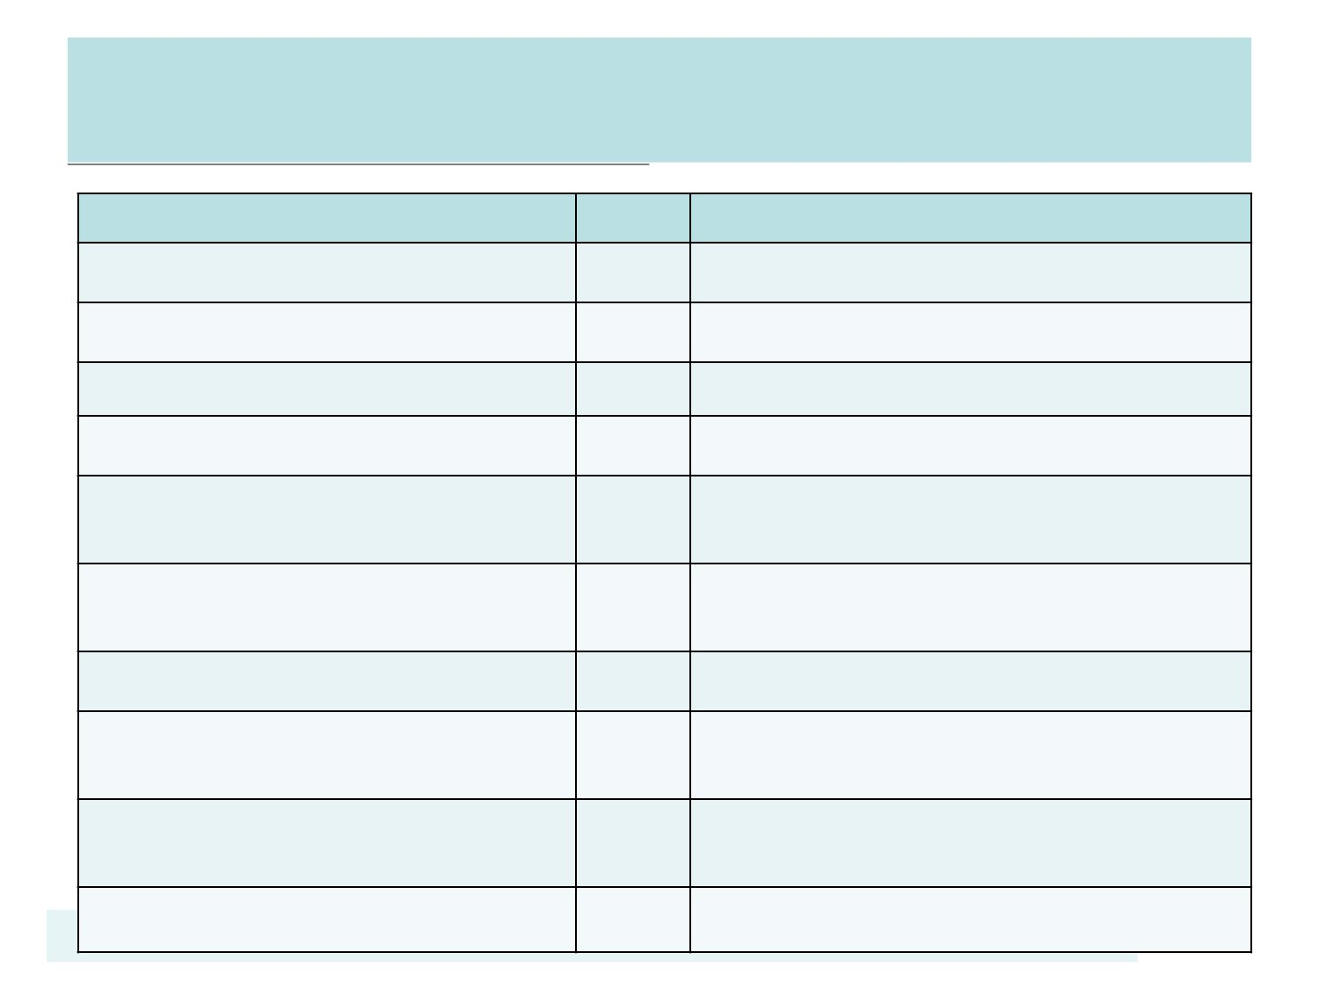
E_WDT_CMD
Enumeration Identifier
Value Description
E_WDT_IOC_START_TIMER 0x0
E_WDT_IOC_STOP_TIMER
E_WDT_IOC_ENABLE_INT
E_WDT_IOC_DISABLE_INT
E_WDT_IOC_ENABLE_WAK 0x4
EUP
E_WDT_IOC_DISABLE_WAK 0x5
EUP
E_WDT_IOC_RESET_TIMER 0x6
E_WDT_IOC_ENABLE_RESE 0x7
T_FUNC
E_WDT_IOC_DISABLE_RESE 0x8
T_FUNC
E_WDT_IOC_SET_INTERVAL 0x9
Start WDT counting
Stop WDT counting
Enable WDT interrupt
Disable WDT interrupt
Enable WDT time-out wake up
function
Disable WDT time-out wake up
function
Reset WDT counter
Enable WDT reset function when
WDT time-out
Disable WDT reset function when
WDT time-out
Set the WDT time-out interval
0x1
0x2
0x3

Slide 24
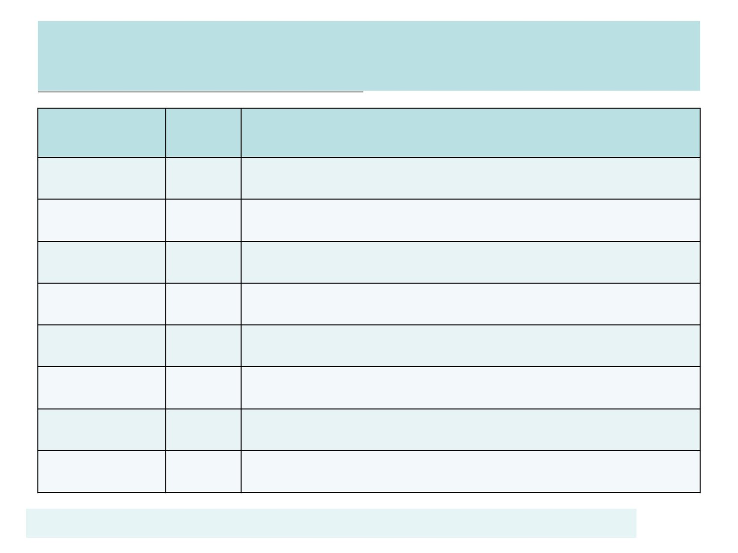
E_WDT_INTERVAL
Enumeration Value
Identifier
E_LEVEL0 0x0
Description
Set WDT time-out interval is 2^4 WDT_CLK
E_LEVEL1
E_LEVEL2
E_LEVEL3
E_LEVEL4
E_LEVEL5
E_LEVEL6
E_LEVEL7
0x1
0x2
0x3
0x4
0x5
0x6
0x7
Set WDT time-out interval is 2^6 WDT_CLK
Set WDT time-out interval is 2^8 WDT_CLK
Set WDT time-out interval is 2^10 WDT_CLK
Set WDT time-out interval is 2^12 WDT_CLK
Set WDT time-out interval is 2^14 WDT_CLK
Set WDT time-out interval is 2^16 WDT_CLK
Set WDT time-out interval is 2^18 WDT_CLK

Slide 25
看門狗初始化(WDT Initial Routine)
1/x
void InitWDT (uint8_t WDT_wtis)
{
UNLOCKREG();
SYSCLK->CLKSEL1.WDT_S =3; //select WDT clock
SYSCLK->APBCLK.WDT_EN =1; //enable WDT clock
WDT->WTCR.WTIS=WDT_wtis ; //select WDT period
WDT->WTCR.WTRE = 1; //enable WDT reset
WDT->WTCR.WTIF =1; //clear WDT interrupt flag
WDT->WTCR.WTIE = 1; //enable WDT interrupt
NVIC->ISER[0] = (1 << 1); // enable IRQ1
WDT->WTCR.WTE = 1; //enable WDT timer
WDT->WTCR.WTR = 1; //reset WDT timer
LOCKREG();
}

Slide 26
看門狗中斷處理常式 (WDT Interrupt Routine)
2/x
void WDT_IRQHandler(void) //自己撰寫
{
// if the fault can be celar, reset watchdog and return
//UNLOCKREG();
//1=Reset the Contents of the Watchdog timer
//WDT->WTCR.WTR = 1;
//WDT->WTCR.WTIF = 1;
//LOCKREG();
// otherwise, store fault status before reset
}

Slide 27
看門狗中斷處理常式 (WDT Interrupt Routine)
3/x
void main (void) //自己撰寫
{
InitWDT(6, WDTCallback);
while(1)
{
…
UNLOCKREG();
//1=Reset the Contents of the Watchdog timer
WDT->WTCR.WTR = 1;
LOCKREG();
}
}

Slide 28
看門狗初始化(WDT Initial Routine)
1/x
void InitWDT (E_WDT_INTERVAL WDT_wtis,WDT_CALLBACK
WDTCallback)
{
UNLOCKREG();
//select WDT clock
DrvSYS_SelectIPClockSource(E_SYS_WDT_CLKSRC,3);
// Enable WDT and Select Timeout Interval
DrvWDT_Open(WDT_wtis);//select WDT period
//enable WDT interrupt reset function
DrvWDT_Ioctl(E_WDT_IOC_ENABLE_RESET_FUNC,0);
//enable WDT interrupt enable

Slide 29
看門狗初始化(WDT Initial Routine)
2/x
//: WatchDog Timer Interrupt Enable (write-protection bit)
DrvWDT_InstallISR(WDTCallback);
//: enable WDT IRQ
NVIC_EnableIRQ(WDT_IRQn); //(NUC1xx.h)WDT_IRQn=1
//NVIC->ISER[0] = (1 << 1); /* enable interrupt */
//enable WDT
DrvWDT_Ioctl(E_WDT_IOC_START_TIMER,1);
//Clear Watchdog Timer (write-protection bit)
DrvWDT_Ioctl(E_WDT_IOC_RESET_TIMER,1);
LOCKREG();
}

Slide 30
看門狗中斷處理常式 (WDT Interrupt Routine)
void WDT_IRQHandler(void) //DrvTIMER.c
{
volatile uint32_t uWakeupFlag;
uWakeupFlag = WDT->WTCR.WTWKF; /* Stored WDT wakeup flag */
3/x
WDT->WTCR.WTIF = 1;
/* Clear the WDT INT Flag */
if (fnCallBack_WDT)
{
fnCallBack_WDT(uWakeupFlag);
}
}

Slide 31
看門狗中斷處理常式 (WDT Interrupt Routine)
4/x
void WDT_Callback(uint32_t i) //自己撰寫
{
// if the fault can be celar, reset watchdog and return
//UNLOCKREG();
// reset watchdog timer
//DrvWDT_Ioctl(E_WDT_IOC_RESET_TIMER,1);
//LOCKREG();
// otherwise, store fault status before reset
}

Slide 32
看門狗中斷處理常式 (WDT Interrupt Routine)
5/x
void main (void) //自己撰寫
{
InitWDT();
while(1)
{
…
UNLOCKREG();
// reset watchdog timer
DrvWDT_Ioctl(E_WDT_IOC_RESET_TIMER,1);
LOCKREG();
}
}

Slide 33
範例1 在7段顯示器顯示0000-9999
1.在7段顯示器顯示0000-9999
2. 啟用WatchDog
- Clock source=10KHz
- WatchDog interval=6 (6.5536second)
- Enable WatchDog reset

Slide 34
範例1 在7段顯示器顯示0000-9999
1/x
int32_t main (void)
{
// set variable
int32_t i;
// Initial WatcgDog
InitWDT(E_WDT_LEVEL6,WDTCallback);
// Initial 7-seg.
seven_segment_open();

Slide 35
範例1 在7段顯示器顯示0000-9999
2/x
for (i=0; i<10000; i++)
// counting 0~9999
{
// display value to 7-segment display
seg_display(i);
// reset WatcgDog
UNLOCKREG();
DrvWDT_Ioctl(E_WDT_IOC_RESET_TIMER,1);
LOCKREG();
}
}

Slide 36
範例1 在7段顯示器顯示0000-9999
3/x
void WDTCallback(uint32_t i)
{
// if the fault can be celar, reset watchdog and return
// reset WatcgDog
//UNLOCKREG();
//DrvWDT_Ioctl(E_WDT_IOC_RESET_TIMER,1);
//LOCKREG();
// otherwise, store fault status before reset
}

Slide 37
範例1 在7段顯示器顯示0000-9999
4/x
void InitWDT(E_WDT_INTERVAL WDT_wtis,WDT_CALLBACK
WDTCallback)
{
UNLOCKREG();
// Step 1. Select WDT clock source, 10KHz
DrvSYS_SelectIPClockSource(E_SYS_WDT_CLKSRC,3);
// Step 2. Enable WDT and Select Timeout Interval
DrvWDT_Open(WDT_wtis); //(DrvTIMER.c)
// Step 3. Enable Watchdog Timer Reset function
DrvWDT_Ioctl(E_WDT_IOC_ENABLE_RESET_FUNC, 1);

Slide 38
範例1 在7段顯示器顯示0000-9999
5/x
// Step 4. Enable WDT interrupt
//: WatchDog Timer Interrupt Enable (write-protection bit)
DrvWDT_InstallISR(WDTCallback);
NVIC_EnableIRQ(WDT_IRQn); //(NUC1xx.h) WDT_IRQn=1
// Step 5. enable WDT clock source and reset WDT timer
//: Watchdog Timer Enable (write-protection bit)
DrvWDT_Ioctl(E_WDT_IOC_START_TIMER,1);
//: Clear Watchdog Timer (write-protection bit)
DrvWDT_Ioctl(E_WDT_IOC_RESET_TIMER,1);
LOCKREG();
}

Slide 39
範例2 在7段顯示器顯示0000-9999
1.在7段顯示器顯示0000-9999
2. 啟用WatchDog
- Clock source=10KHz
- WatchDog interval=6 (6.5536second)
- Enable WatchDog reset
3. 在主迴圈關閉WatchDog的reset功能，使得WatchDog逾時
，產生reset。

Slide 40
範例2 在7段顯示器顯示0000-9999
1/x
int32_t main (void)
{
// set variable
int32_t i;
// Initial WatcgDog
InitWDT(E_WDT_LEVEL6,WDTCallback);
// Initial 7-seg.
seven_segment_open();

Slide 41
範例2 在7段顯示器顯示0000-9999
2/x
for (i=0; i<10000; i++)
// counting 0~9999
{
// display value to 7-segment display
seg_display(i);
// reset WatcgDog
UNLOCKREG();
DrvWDT_Ioctl(E_WDT_IOC_RESET_TIMER,1);
LOCKREG();
}
}

Slide 42
範例2 在7段顯示器顯示0000-9999
3/x
void WDTCallback(uint32_t i)
{
// if the fault can be celar, reset watchdog and return
// reset WatcgDog
//UNLOCKREG();
//DrvWDT_Ioctl(E_WDT_IOC_RESET_TIMER,1);
//LOCKREG();
// otherwise, store fault status before reset
}

Slide 43
範例2 在7段顯示器顯示0000-9999
4/x
void InitWDT(E_WDT_INTERVAL WDT_wtis,WDT_CALLBACK
WDTCallback)
{
UNLOCKREG();
// Step 1. Select WDT clock source, 10KHz
DrvSYS_SelectIPClockSource(E_SYS_WDT_CLKSRC,3);
// Step 2. Enable WDT and Select Timeout Interval
DrvWDT_Open(WDT_wtis); //(DrvTIMER.c)
// Step 3. Enable Watchdog Timer Reset function
DrvWDT_Ioctl(E_WDT_IOC_ENABLE_RESET_FUNC, 1);

Slide 44
範例2 在7段顯示器顯示0000-9999
5/x
// Step 4. Enable WDT interrupt
//: WatchDog Timer Interrupt Enable (write-protection bit)
DrvWDT_InstallISR(WDTCallback);
NVIC_EnableIRQ(WDT_IRQn); //(NUC1xx.h) WDT_IRQn=1
// Step 5. enable WDT clock source and reset WDT timer
//: Watchdog Timer Enable (write-protection bit)
DrvWDT_Ioctl(E_WDT_IOC_START_TIMER,1);
//: Clear Watchdog Timer (write-protection bit)
DrvWDT_Ioctl(E_WDT_IOC_RESET_TIMER,1);
LOCKREG();
}

Slide 45
範例3 在7段顯示器顯示0000-9999
1.在7段顯示器顯示0000-9999
2. 啟用WatchDog
- Clock source=10KHz
- WatchDog interval=6 (6.5536second)
- Enable WatchDog reset

Slide 46
範例3 在7段顯示器顯示0000-9999
1/x
int32_t main (void)
{
// set variable
int32_t i;
// Initial WatcgDog
InitWDT(6);
// Initial 7-seg.
seven_segment_open();

Slide 47
範例3 在7段顯示器顯示0000-9999
2/x
for (i=0; i<10000; i++) // counting 0~9999
{
// display value to 7-segment display
seg_display(i);
// reset WatcgDog
UNLOCKREG();
//1=Reset the Contents of the Watchdog timer
WDT->WTCR.WTR = 1;
LOCKREG();
}
}

Slide 48
範例3 在7段顯示器顯示0000-9999
3/x
void WDTCallback(uint32_t i)
{
// if the fault can be celar, reset watchdog and return
// reset WatcgDog
//UNLOCKREG();
//1= clear WatchDog Timer Interrupt Flag
//WDT->WTCR.WTIF = 1;
//1=Reset the Contents of the Watchdog timer
//WDT->WTCR.WTR = 1;
//LOCKREG();
// otherwise, store fault status before reset
}

Slide 49
範例3 在7段顯示器顯示0000-9999
4/x
void InitWDT(uint8_t WDT_wtis){
UNLOCKREG();
// Step 1. Select WDT clock source, 10KHz
//DrvSYS_SelectIPClockSource(E_SYS_WDT_CLKSRC,3);
SYSCLK->CLKSEL1.WDT_S =3;
// Step 2. Enable WDT and Select Timeout Interval
//DrvWDT_Open(WDT_wtis); //(DrvTIMER.c)
//: 2.1Watchdog Timer Clock Enable (write-protection bit)
SYSCLK->APBCLK.WDT_EN = 1;
//: 2.2Watchdog Timer Enable (write-protection bit)
WDT->WTCR.WTE = 0;
//: 2.3Watchdog Timer Interval Select (write-protection bits)
WDT->WTCR.WTIS = WDT_wtis;

Slide 50
範例3 在7段顯示器顯示0000-9999
5/x
// Step 3. Enable Watchdog Timer Reset function
//DrvWDT_Ioctl(E_WDT_IOC_ENABLE_RESET_FUNC, 1);
//:VTCR[1]1 = Enable Watchdog timer reset function
WDT->WTCR.WTRE = 1;
// Step 4. Enable WDT interrupt
//: WatchDog Timer Interrupt Enable (write-protection bit)
//DrvWDT_InstallISR(WDTCallback);
WDT->WTCR.WTIE = 1;
//NVIC_EnableIRQ(WDT_IRQn); //(NUC1xx.h) WDT_IRQn=1
NVIC->ISER[0] = (1 << 1);

Slide 51
範例3 在7段顯示器顯示0000-9999
6/x
// Step 5. enable WDT clock source and reset WDT timer
//: Watchdog Timer Enable (write-protection bit)
//DrvWDT_Ioctl(E_WDT_IOC_START_TIMER,1);
WDT->WTCR.WTE = 1;
//: Clear Watchdog Timer (write-protection bit)
//DrvWDT_Ioctl(E_WDT_IOC_RESET_TIMER,1);
//WDT->WTCR.WTR = 1;
LOCKREG();
}

Slide 52
範例4 在7段顯示器顯示0000-9999
1.在7段顯示器顯示0000-9999
2. 啟用WatchDog
- Clock source=10KHz
- WatchDog interval=6 (6.5536second)
- Enable WatchDog reset
3. 在主迴圈關閉WatchDog的reset功能，使得WatchDog逾時
，產生reset。

Slide 53
範例4 在7段顯示器顯示0000-9999
1/x
int32_t main (void)
{
// set variable
int32_t i;
// Initial WatcgDog
InitWDT(6);
// Initial 7-seg.
seven_segment_open();

Slide 54
範例4 在7段顯示器顯示0000-9999
2/x
for (i=0; i<10000; i++) // counting 0~9999
{
// display value to 7-segment display
seg_display(i);
// reset WatcgDog
UNLOCKREG();
//1=Reset the Contents of the Watchdog timer
WDT->WTCR.WTR = 1;
LOCKREG();
}
}

Slide 55
範例4 在7段顯示器顯示0000-9999
3/x
void WDTCallback(uint32_t i)
{
// if the fault can be celar, reset watchdog and return
// reset WatcgDog
//UNLOCKREG();
//1= clear WatchDog Timer Interrupt Flag
//WDT->WTCR.WTIF = 1;
//1=Reset the Contents of the Watchdog timer
//WDT->WTCR.WTR = 1;
//LOCKREG();
// otherwise, store fault status before reset
}

Slide 56
範例4 在7段顯示器顯示0000-9999
4/x
void InitWDT(uint8_t WDT_wtis){
UNLOCKREG();
// Step 1. Select WDT clock source, 10KHz
//DrvSYS_SelectIPClockSource(E_SYS_WDT_CLKSRC,3);
SYSCLK->CLKSEL1.WDT_S =3;
// Step 2. Enable WDT and Select Timeout Interval
//DrvWDT_Open(WDT_wtis); //(DrvTIMER.c)
//: 2.1Watchdog Timer Clock Enable (write-protection bit)
SYSCLK->APBCLK.WDT_EN = 1;
//: 2.2Watchdog Timer Enable (write-protection bit)
WDT->WTCR.WTE = 0;
//: 2.3Watchdog Timer Interval Select (write-protection bits)
WDT->WTCR.WTIS = WDT_wtis;

Slide 57
範例4 在7段顯示器顯示0000-9999
5/x
// Step 3. Enable Watchdog Timer Reset function
//DrvWDT_Ioctl(E_WDT_IOC_ENABLE_RESET_FUNC, 1);
//:VTCR[1]1 = Enable Watchdog timer reset function
WDT->WTCR.WTRE = 1;
// Step 4. Enable WDT interrupt
//: WatchDog Timer Interrupt Enable (write-protection bit)
//DrvWDT_InstallISR(WDTCallback);
WDT->WTCR.WTIE = 1;
//NVIC_EnableIRQ(WDT_IRQn); //(NUC1xx.h) WDT_IRQn=1
NVIC->ISER[0] = (1 << 1);

Slide 58
範例4 在7段顯示器顯示0000-9999
6/x
// Step 5. enable WDT clock source and reset WDT timer
//: Watchdog Timer Enable (write-protection bit)
//DrvWDT_Ioctl(E_WDT_IOC_START_TIMER,1);
WDT->WTCR.WTE = 1;
//: Clear Watchdog Timer (write-protection bit)
//DrvWDT_Ioctl(E_WDT_IOC_RESET_TIMER,1);
//WDT->WTCR.WTR = 1;
LOCKREG();
}

